Slide 1

DEPI PROJECT
AUTOMATION EXERCISE

Slide 2



TEAM MEMBERS
▪︎ MAHMOUD KHALED HEGAZY
▪︎ EZZAT ADEL EZZAT
▪︎ JANA AYMAN HAZEM
▪︎ HAGER WAHEED AHMED
▪︎ MOHAMED WAHID MOHAMED

Slide 3

INTRODUCTION
This project presents a complete testing process applied to the system, including Manual, API, Database, and Automation Testing.
The aim is to ensure functionality, accuracy, data integrity, and overall system quality.
The following sections outline the testing approach, tools used, executed test scenarios, and achieved results.

Slide 4


AUTOMATION
EXERCISE
Automation Exercise is a demo website used by QA testers to practice different types of testing in one place. It provides many features such as login, signup, products, cart, orders, forms, APIs, and database simulation. We used it in our project to perform Manual Testing, API Testing, Database Testing, Automation Testing, and also applied BDD."

Slide 5


DATABASE OPENCART
OpenCart is an open-source e-commerce platform used to build and manage online stores. It provides features like product management, user accounts, shopping cart, checkout, payment methods, and admin dashboard. We used OpenCart in our project to test real e-commerce workflows through Manual Testing, API Testing, Database Testing, Automation Testing, and applying BDD.

Slide 6

PROJECT TOOLS & TECHNIQUES:
API Testing: Used Postman to verify server responses and data integrity on Automation Exercise.
Manual Testing: Checked website features step by step to ensure correct functionality.
Automation Testing: Implemented with Java + Selenium on IntelliJ IDEA to execute repetitive tests efficiently.
Database Testing: Verified OpenCart database to ensure accurate handling of products, orders, and user data.

Slide 7

MANUAL TESTING
Manual Testing:
Testing software manually without using automation tools.
Testers follow test cases step by step to check if the application works correctly.
Helps identify bugs, usability issues, and unexpected behavior.
In this project:
Manual testing was used to verify website functions before automating tests.
Ensures that the Automation Exercise website behaves as expected for real users.

Slide 8

AUTOMATION TESTING
Automation Testing:
Testing software using automated tools or scripts instead of manually.
Helps run repetitive tests quickly and accurately.
Detects bugs and issues early, saving time and effort.
In this project:
Automated tests were used to validate the functionalities of the Automation Exercise website.
Ensures consistent and reliable testing for different scenarios.

Slide 9

Ensures that the data in the database is accurate, consistent, and secure.
Validates operations like inserting, updating, deleting, and retrieving data.
Detects data-related issues that can affect application functionality.
In this project (OpenCart):
Tested the OpenCart database to ensure products, orders, and user data are handled correctly.
Verified that transactions, user accounts, and inventory updates work as expected.
Helps maintain data integrity and smooth e-commerce operations.
DATABASE TESTING

Slide 10

Allows different software applications to communicate.
Lets developers use functionalities of another system without knowing its internal details.
Used in this project to test Automation Exercise website, ensuring correct responses and smooth functionality.
API (APPLICATION PROGRAMMING INTERFACE)

Slide 11
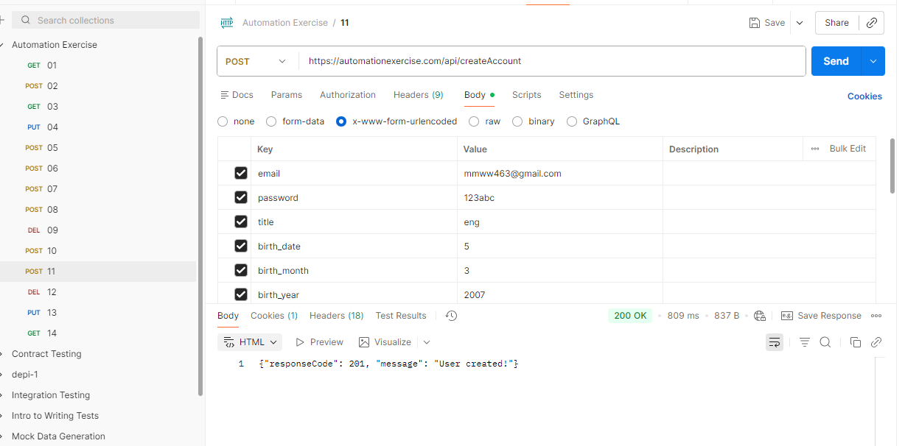
API Overview
Performed API testing for Cart, Checkout, and Payment features using Postman.
Validated backend functionality independent of the UI.
Ensured correct responses, status codes, and data consistency.
Verified API reliability, performance, and error handling.
TEST CASE Overview
Verify that POST Create/Register User Account
Verify that POST Verify Login with invalid details
Verify that POST Search Product without search_product parameter
Verify that DELETE User Account
Verify that POST Search Product
API TEST CASES

Slide 12
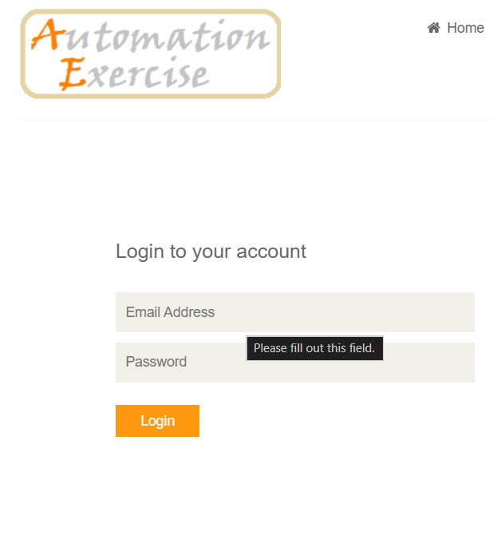
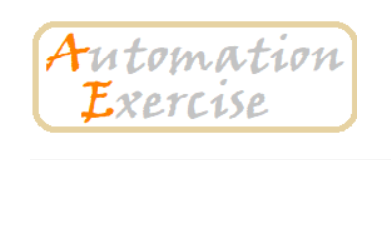
Validate email and password fields.
Check required fields and ensure proper error messages.
Test invalid login and verify warning messages.
Confirm successful login and redirection.
Verify logout functionality and session behavior.
Check password masking and security validations.
Verify navigation links (signup, forgot password).
Validate UI/UX and responsive layout.
LOGIN PAGE

Slide 13
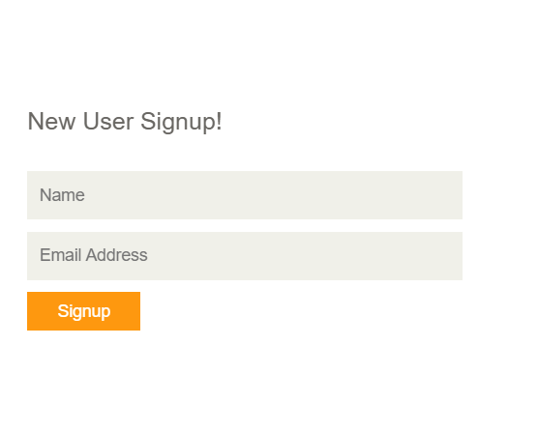
Validate all input fields (name, email, password, address, etc.).
Check required fields and proper error messages.
Test duplicate email and verify error handling.
Validate password masking and rules.
Confirm full signup flow and account creation success.
Verify automatic login after signup.
Test dropdowns, radio buttons, and checkboxes.
Validate UI/UX and mobile responsiveness.
Ensure all buttons and actions work correctly.
SIGNUP PAGE

Slide 14
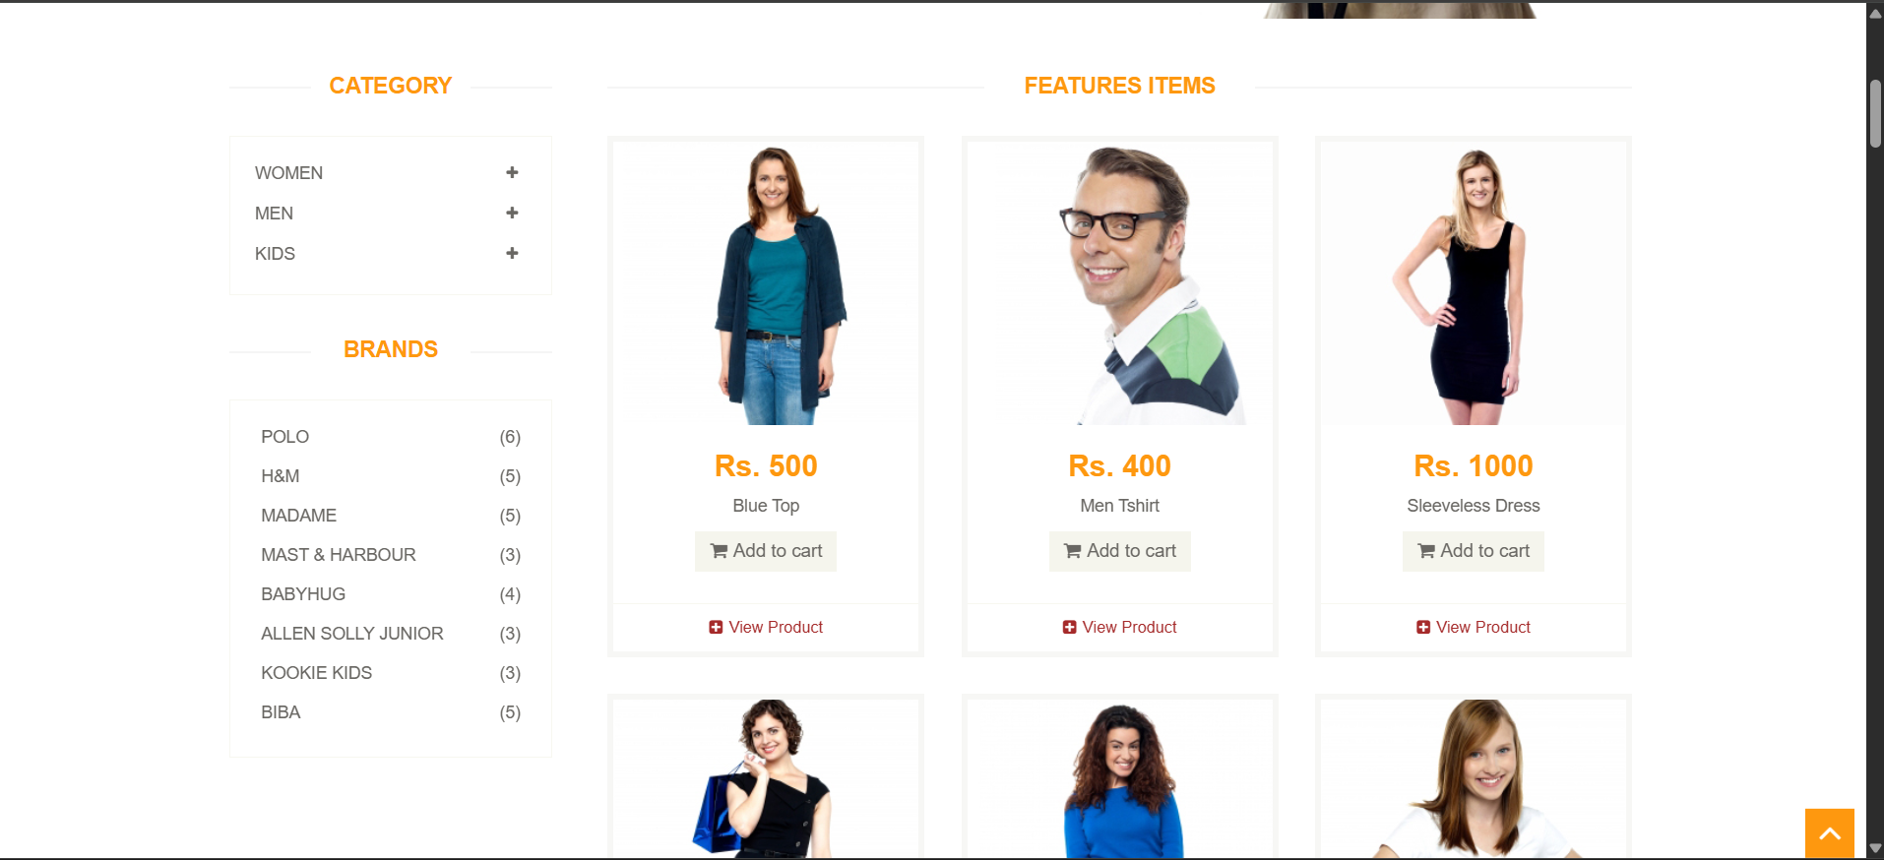
HOME PAGE
Summary
"The Home Page includes the main navbar, product sections, sliders, and the subscription form. We tested its loading, design, and basic functionality."
Test Cases
Home Page loads correctly.
Navbar and sliders appear and work.
Navigation buttons redirect properly.
Subscription form shows success message.
Automation
Automated page loading validation.
Automated subscription test.
Automated navigation clicks.
Used POM and explicit waits.

Slide 15
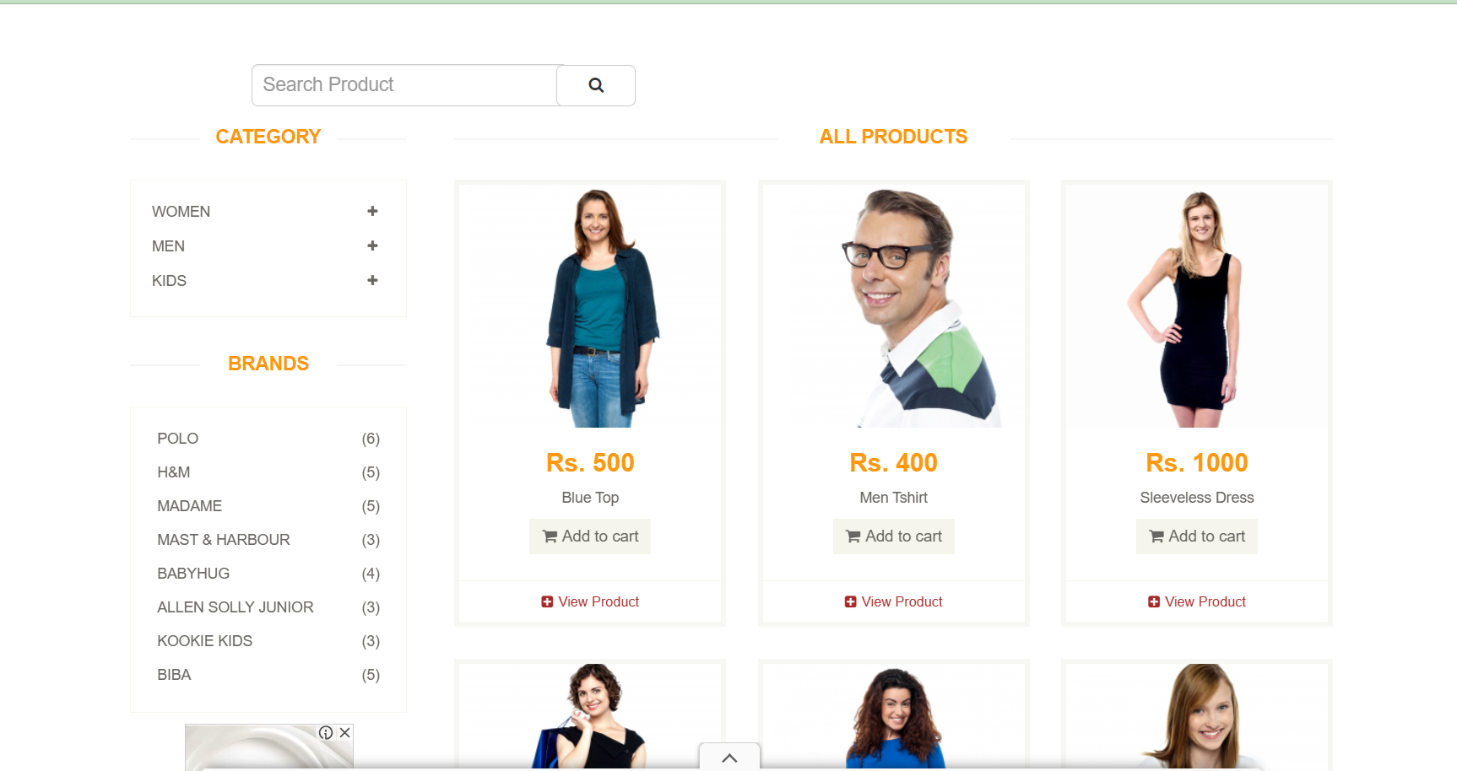
PRODUCT PAGE
Verify product details (name, price, description, category).
Check product images.
Test quantity input (no negative or zero values).
Validate Add to Cart and success messages.
Confirm price calculation and cart total.
Test product reviews (load/add/validation).
Check navigation links and page flow.
Validate UI/UX and responsive design.
Ensure all buttons and page actions work properly.

Slide 16
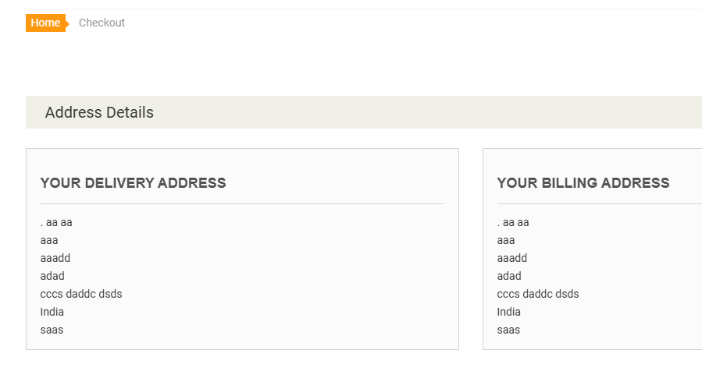
Checkout Page – Overview
Collects user’s billing and shipping details before payment.
Displays form fields: name, email, address, country, state, zip code, phone.
Shows complete order summary (products, quantities, total price).
Contains Place Order button to continue to Payment Page.
Ensures accurate user information for order processing.
CHECK OUT PAGE

Slide 17
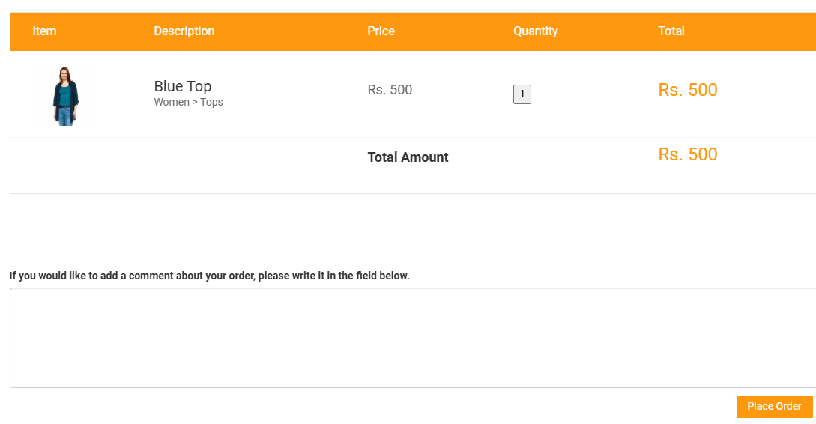
Test Case Overview– Checkout Page
Verify that all required fields accept valid user input.
Ensure validation messages appear for missing or incorrect information.
Confirm that the order summary matches the items in the cart.
Check the “Place Order” button redirects correctly to the Payment Page.
Ensure the page layout displays correctly on different devices
CHECK OUT PAGE

Slide 18
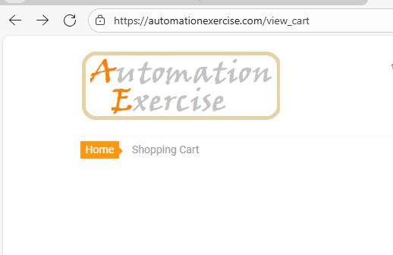
CART PAGE
cart page overview
Displays all items added by the user before checkout.
Shows product image, name, unit price, quantity, and total per item.
Allows updating item quantity or removing products.
Provides a full cart summary including subtotal and total amount.
Contains the “Proceed to Checkout” button to move to the next step.

Slide 19
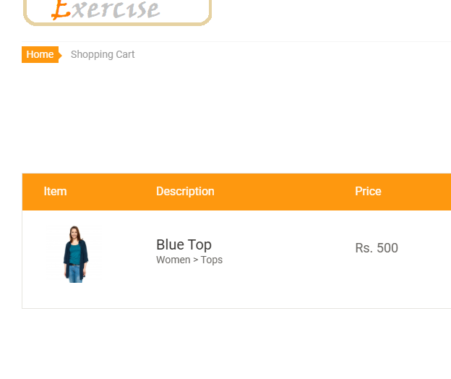
CART PAGE
Test case overview - Cart page
Displays all items added by the user before checkout.
Shows product image, name, unit price, quantity, and total per item.
Allows updating item quantity
Provides a full cart summary including subtotal and total amount.
Contains the “Proceed to Checkout” button to move to the next step.

Slide 20
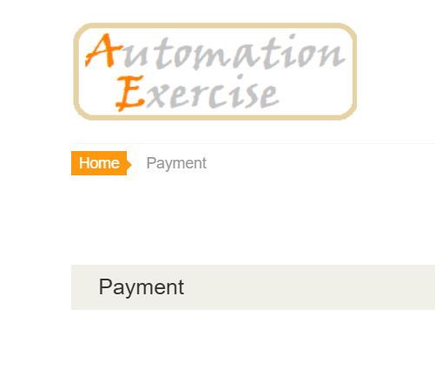
PAYMENT PAGE
The Payment Page is the final step of the checkout process on Automation Exercise.
This page is critical for validating user input and ensuring secure payment processing.
it allows the user to enter payment details after confirming the cart and shipping information.
The main purpose of this page is to securely collect card information (name, number, CVC, expiration).
a successful submission should complete the order and redirect to the confirmation page.

Slide 21
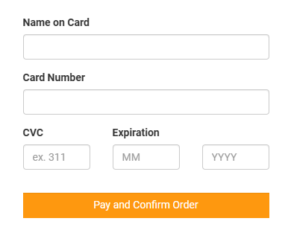
test cases overview
PAYMENT PAGE
1. Positive Test:
Enter valid card , Confirm Order and Click Pay Order should be placed successfully.
2. Negative Tests:
Leave one or more fields empty Error message should appear.
Enter invalid card number (wrong length/characters) → Should show validation error.
Enter expired date Payment should be rejected.
Enter invalid CVC → Should show a. error.
Test error messages displayed for wrong or malformed card details.
3. UI/Functional Checks:
Payment button is clickable and responsive

Slide 22
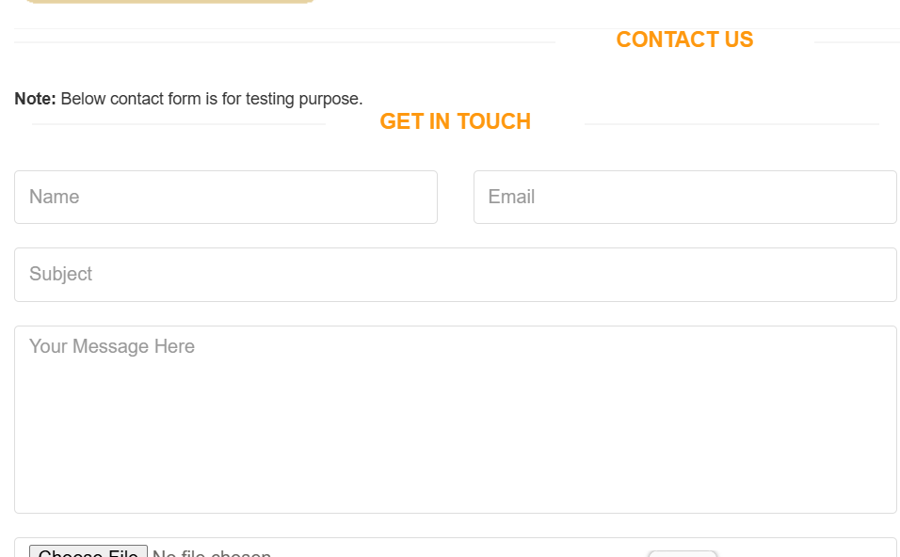
CONTACTUS PAGE
Validate all input fields (Name, Email, Subject, Message).
Check required fields and proper error messages.
Verify email format validation.
Test file upload (size/type/error messages).
Ensure submit button works and shows success message.
Confirm data is delivered/processed correctly.
Check layout and responsiveness across devices.

Slide 23

THANK YOU

